Slide 1
Creating graphs
Year 11 Essentials 2018
Week4 lesson 1

Slide 2
What do we graph?
We create graphs to help us visually represent data
Data has two categories: NUMERICAL and CATEGORICAL
Numerical data is numbers- statistics, temperatures, times, speeds ect.
Categorical data is category groups- colours, brands, flavours, states of matter ect.

Slide 3
Identifying data types: Categorical or Numerical?
Have a go at identifying the type of data of the following data sets:
HASS test results out of 20
Hair colour of people in the class
Favourite shoe brand
Pineapple on a pizza?
Kill death ratio on Fortnite
ANSWERS:
1: N, 2:C, 3:C, 4:C and yes, 5:N

Slide 4
Which and when?
Knowing about data, allows us to select the correct graph:
Copy this table to help you remember what graph is appropriate for which data type.
Categorical | Numerical
Column/Bar Pie | Line Pictograph Conversion/Rates graph.

Slide 5
What is a good graph?
There are Good and Bad graphs
Good graphs have all of the following, while bad graphs are missing some of these;
Title
Labelled axes
Standard unitary amounts(1’s, 5’s,10s’ ect) that are appropriate for the application
A Key to show what different colours or sectors are.

Slide 6
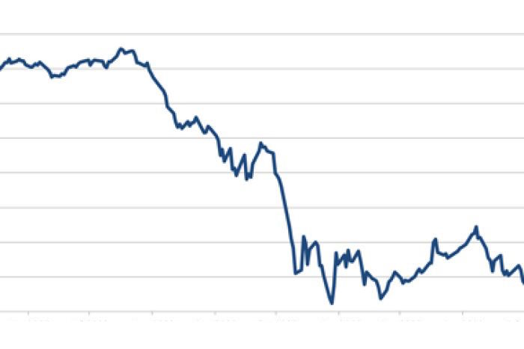
What makes a good graph?
Is this a good graph?
Yes? No? Why is it a bad graph?
Discuss in your groups as to what makes this graph bad?

Slide 7
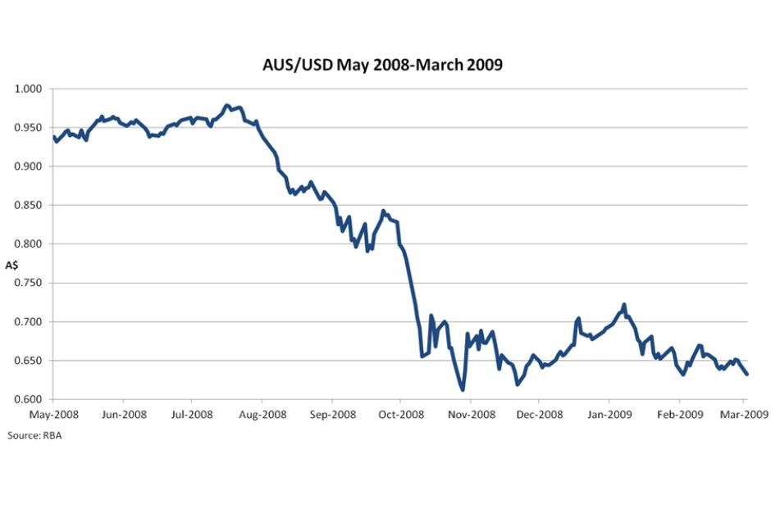
Making it better
The previous graph was poor, as it did not have;
A Title
A Scale
Labelled Axes
The previous graph was printed in the West Australian newspaper as it was before, and caused panic amongst people as the AUD was thought to be plummeting towards $0.00 instead of only $0.60.

Slide 8
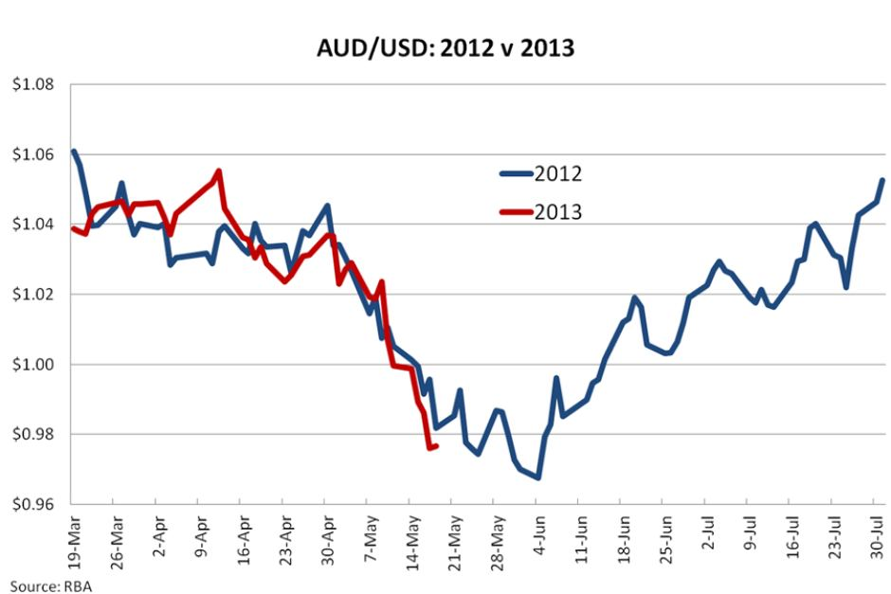
Other features
Keeping in a similar context, this graph shows a comparison of two similar data sets- what good features of the graph do you notice?
Key?
Labelled Axes?
Title?
Standard units?
✓ ✓ ✓ ✓

Slide 9
Recall: TED ED Graph Video
Remembering what the TED ED Video said about graphs, determine the type of graph you would use for the following data types:
Peoples favourite ice cream flavours
Male and Female shoe sixes being compared
J.D. Power Car reliability score by Brand and Volume sold
Average weather temperatures over the months of 2017 / 2018
ANSWERS (some may vary if you can argue your point)
1-pie chart/column. 2-clustered column. 3 Column Graph(axes labels), 4. Line graph

Slide 10
Constructing a graph
A science class recorded the temperatures of water at 3 minute intervals as it cooled from boiling.
On the graph paper provided, create a line graph for the following information:
Remember to include the key components of good graphs.
Time (Minute) | Salt Water (degrees C) | Distilled Water (degrees C)
3 | 102 | 94
6 | 89 | 84
9 | 64 | 64
12 | 39 | 34
15 | 29 | 24 (ambient)

Slide 11
Comparison- Yours and mine
Does your graph look similar to this one?
Why or Why not? Is this a good graph?

Slide 12
Activity
Create a set of axes with the following values: “Kilometres” on the y axis, and “hours” on the x-axis.
Using the data below, graph a conversion line for each animal. (assuming each animal maintains a constant speed)
Distance (km) | 1 | 2 | 3 | 4 | 5 | Speed (km/hr)
Chicken | 4hr | 8hr | 12hr | 16hr | 20hr
Pigeon | 2hr | 4hr | 6hr | 8hr | 10hr
Squirrel | 3hr | 6hr | 9hr | 12hr | 15hr
Cat | 1.5hr | 3hr | 4.5hr | 6hr | 7.5hr
Dog | 0.5hr | 1hr | 1.5hr | 2hr | 2.5hr
Fox | 0.25hr | 0.5hr | 0.75hr | 1.0hr | 1.5hr
Using your graph and a ruler, estimate how long it would take each animal to run 3.25km, 2.75km and 4.33km.
Next, using the other axis, estimate how far they run after 2.5hours, 4 hours and 3 hours

Slide 13
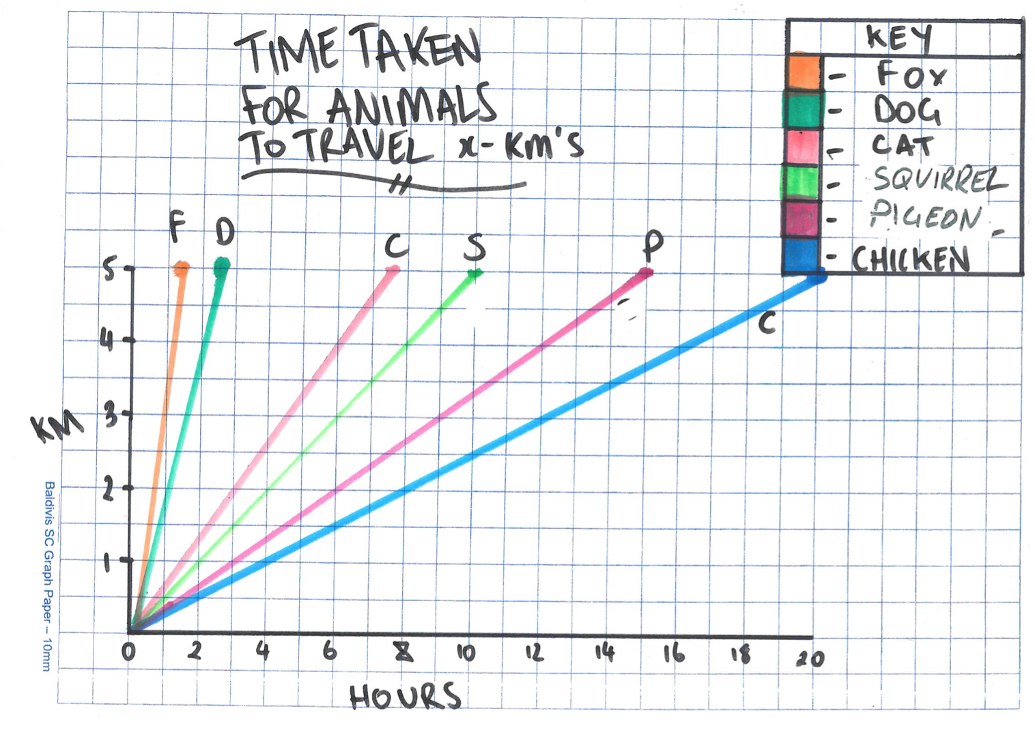
GRAPH

